Slide 1
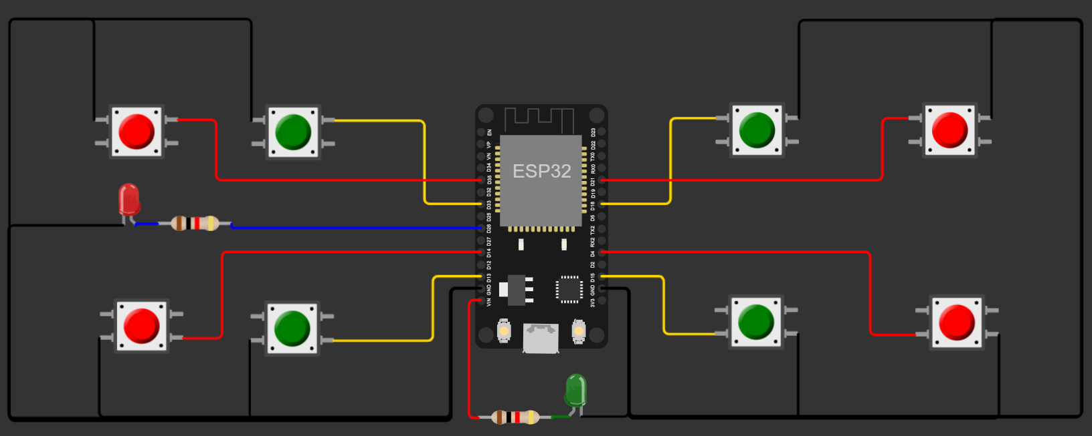
COUNTER 2
COUNTER 4
WIFI LED
COUNTER 1
ON LED
COUNTER 3

